Slide 1

Garment Employees Productivity Prediction
Mini-Project 1
Spring Dai
July 2021

Slide 2
Outline
Business Context
Business Question
Data Pipeline
Data Overview/EDA
Hypothesis Test
Prediction
Summary/Next Step

Slide 3

Business Context
The Garment Industry is one of the key examples of highly labor-intensive industry.
The employees’ performance is critical for global demand and orders fulfillment.
Business Questions?
What factors will influence employees’ productivity? What are top ones?
Is there any way to predict the productivity performance?

Slide 4
Pipeline
Define
Data source
Prepare
Data load
Explore
Feature Profiling
Hypothesize
Build Model
Business question
Data transform
Data clean
Correlation matrix
Features impact assessment
Prediction model
Model Cross validation

Slide 5
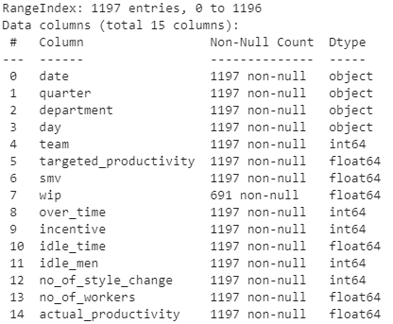
Dataset Overview
garments_worker_productivity.csv(quoted from Kaggle)
1197 records
14 features
1 response output

Slide 6
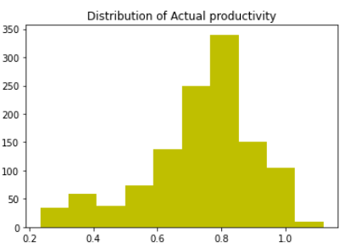
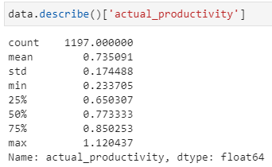
Response Features Analysis
Mean is closed to median value
Sample is similar to normal distribution

Slide 7
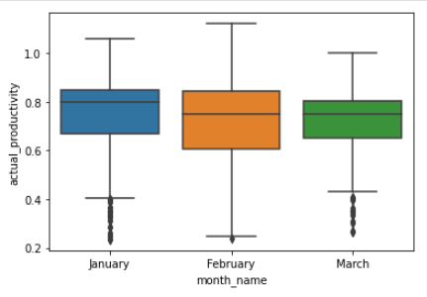
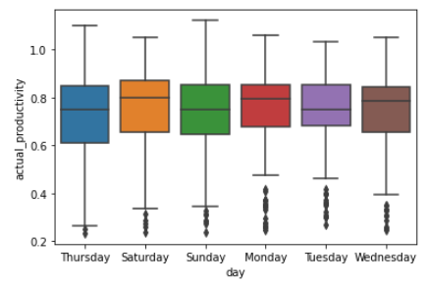
Categorical Features Analysis
High productivities are observed in both Jan and Saturday.
People tend to have high performance after rest
Jan is after New Year Holiday
Saturday is after Friday(Friday is not work day per dataset)

Slide 8
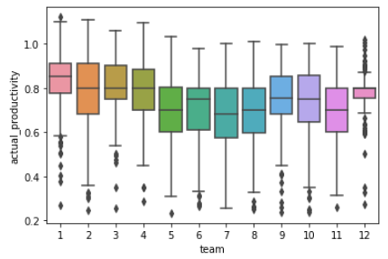
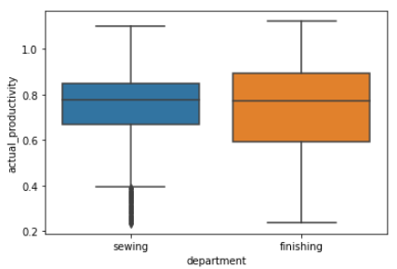
Categorical Features Analysis
There is team to team performance variance(both median and variance)
Department to department performance looks almost equivalent

Slide 9
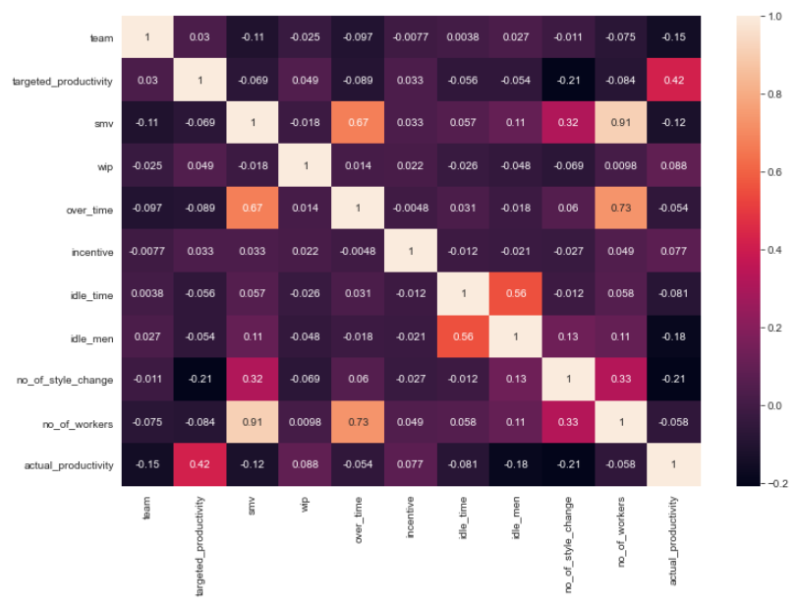
Correlation Matrix
Top 3
Positive Correlated features
Targeted_productivity
Wip(wait-in-process)
incentive
Top 3
Negative Correlated features
no_of_style_change
Idle_man
Smv(standard minute value)
Hypothesis Test:
Incentive
No_of_style_change

Slide 10
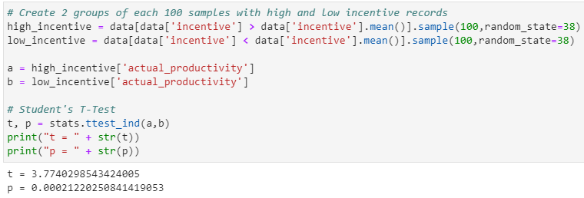
Hypothesis-1 Incentive makes significant difference?
Process:
Create 2 groups of each 100 samples with high and low incentive records
Hypothesis using Student’s T-Test(2 samples)
Significance level(Alpha): 5%
H0: There are no differences in actual productivity between low and high incentive groups.
H1: There are differences in actual productivity between low and high incentive groups.
Result:
P-Value is < 0.05 (T-Test screenshot)
We will reject the Null Hypothesis
Conclusion:
High and low incentive will make significant difference

Slide 11
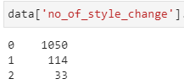
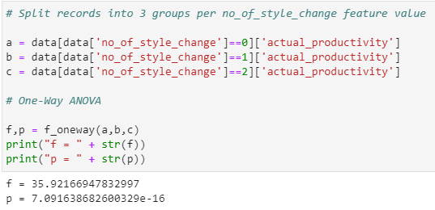
Hypothesis-2 style change# makes significant difference?
Process:
Split records into 3 groups per no_of_style_change feature value(Available value screenshot)
Hypothesis using One-way ANOVA (3 groups)
Significance level(Alpha): 5%
H0: There are no differences in actual productivity among 3 different groups.
H1: There are differences in actual productivity among 3 different groups.
Result:
P-Value is < 0.05 (T-Test screenshot)
We will reject the Null Hypothesis
Conclusion:
Style change# will make significant difference

Slide 12
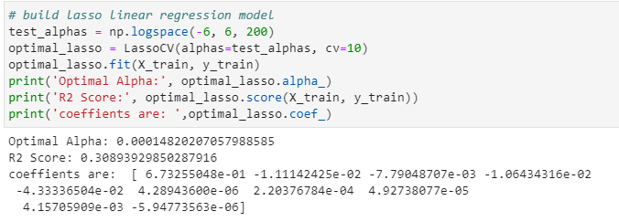
Prediction Model
Consideration:
Put all 10 numerical features into the prediction model training
Linear regression Lasso will be used to avoid overfitting and select features
20% of records will be secured for test purpose
Cross validation(10x) will be conducted for result accuracy
Model Result:
Optimal Lasso alpha value: 0.000148
All features’ coefficients are defined
R2 Value: 30.9% (refer to screenshot)

Slide 13
Summary
Different months/days influence people productivity
People back from holiday/rest tend to perform better
Features drive people/team performance
Target Setting
Incentive
Process/Task simplification
Features lower people/team performance
Over time
Idle time
Idle people

Slide 14
Next Steps
Explore by adding categorical features into prediction model
Optimize the prediction model for better score
Optimize selected features
Explore other available regression model

Slide 15
Thank You!

Slide 16
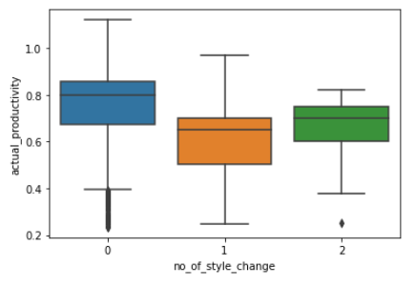
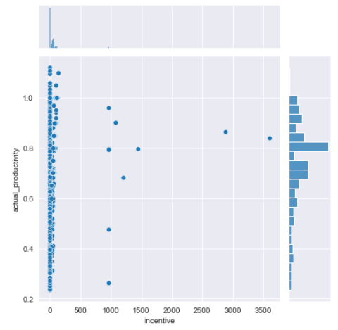
Continuous Features Analysis
Simple garment (No style change) tends to have high people productivity
There is no significant linear correlation between incentive and productivity

Slide 17
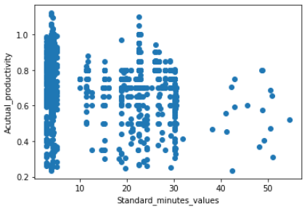
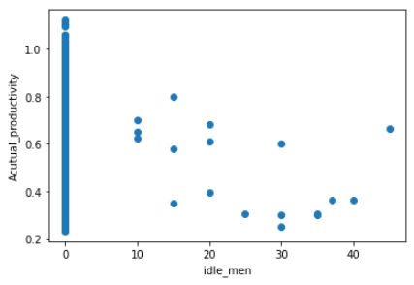
Continuous Features Analysis
Moderate negative correlated between SMV and productivity
Moderate negative correlated between idle men and productivity

